Slide 1
Software Design and Architecture [CMP 340]
Lab works

Slide 2
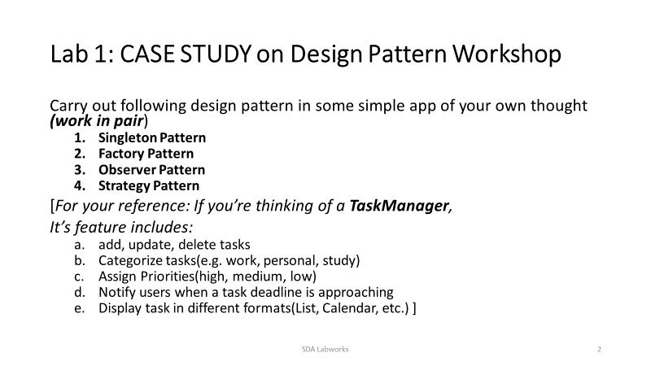

Slide 3
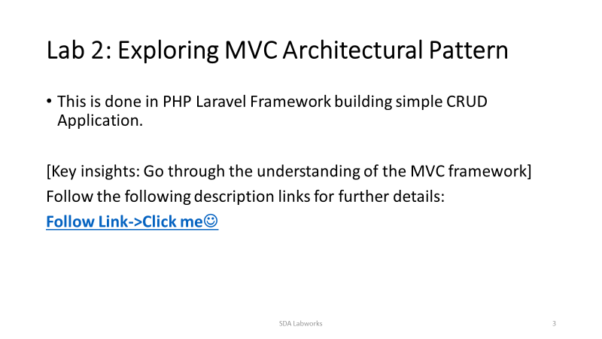
https://medium.com/@rockwithmadan/todo-list-using-php-laravel-and-mysql-with-basic-crud-dd98ca7c57f8

Slide 4
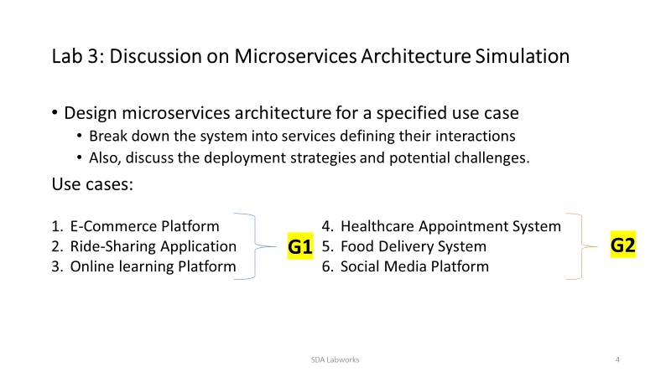

Slide 5
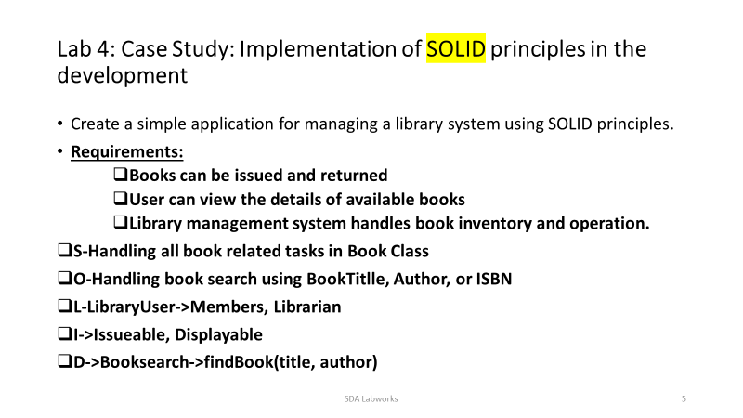

Slide 6
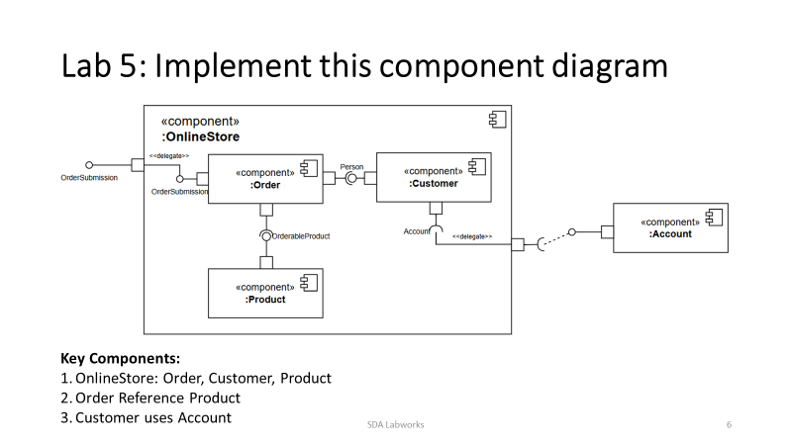

Slide 7
